Slide 1
CSC 3210 Computer Organization and Programming
Lab Work 8
Georgia State University
Spring 2024

Slide 2
Learning Objective
Indirect Addressing & Indexed Operands, Loop instruction, and Logical Instructions

Slide 3
Disclaimer
The process shown in these slides might not work in every single computer due to Operating system version, Microsoft Visual Studio versions and everything.
If you find any unusual error, you can inform the instructor.
Instructor will help you resolve the issue.

Slide 4
Lab Work 8 Instructions
Lab 8(a): Loop instruction
Lab 8(b): Nested Loop
Lab 8(c): Logical Instruction
Due Date: posted on icollege

Slide 5
Plan early …
You have one week time to submit the lab
Start early
If you have issues
Email TA or instructor
Stop by during office hours
Start working at the last moment is not a good idea.
AppendixA shows how to check memory data and Appendix B shows how to create a new project.

Slide 6
Problems in this lab
Before running the problems in Visual studio,
You can try to solve them in a paper for practice.
You might see similar questions in the quizzes and exam.
During the exam you might need solve similar problems without visual studio.

Slide 7
Directions
Create a new application for every question.
Do not use one application with multiple .asm files
The Appendix has the steps for creating a new project

Slide 8
Lab 8(a) Loop instruction
Submission

Slide 9
Loop Instruction
Write and run a program to find the values of each destination operand:
; Summing an Array (SumArray.asm)
.data
intarray DWORD 10000h,20000h,30000h,40000h
.code
main PROC
mov edi, 0 ; 1. initialize index
mov ecx,LENGTHOF intarray ; 2: initialize loop counter
mov eax,0 ; 3: sum = 0
L1: ; 4: mark beginning of loop
add eax, intarray[edi] ; 5: add an integer
add edi,TYPE intarray ; 6: point to next element
loop L1 ; 7: repeat until ECX = 0
EAX =?

Slide 10
Submission Instruction – 8(a)
Debug until you reach “INVOKE ExitProcess, 0”.
Take a Single screenshot of the code and register window at the end
Record the content of the EAX register

Slide 11
Lab 8(b) Nested loop
Submission

Slide 12
Nested Loop
Problem 3: Write and run a program to find the values of each destination operand:
.data
temp dword ?
.code
mov eax,0
mov ecx,10 ; outer loop counter
L1:
mov eax,3
mov temp,ecx
mov ecx,5 ; inner loop counter
L2:
add eax,5
loop L2 ; repeat inner loop
mov ecx, temp
loop L1 ; repeat outer loop
EAX =?

Slide 13
Submission Instruction – 8(b)
Debug until you reach “INVOKE ExitProcess, 0”.
Take a Single screenshot of the code and register window at the end
Record the EAX register.

Slide 14
Lab 8(c) Logical Instructions
Submission

Slide 15
Logical Instructions
Problem 4: Write and run a program to find the values of each destination operand:
.code
mov al,01101111b
and al,00101101b ; a. Al= ?
mov al,6Dh
and al,4Ah ; b. Al= ?
mov al,00001111b
or al,61h ; c. Al= ?
mov al,94h
xor al,37h ; d. Al= ?

Slide 16
Submission Instruction – 8(c)
What are the Contents of AL register in last slide?

Slide 17
Appendix A
Checking Memory Data

Slide 18
Checking Memory Data
Use Memory window to verify the values of memory locations.
To activate Memory window, run the debugger, go to debug menu and click on windows, open it, go to Memory then choose Memory1.
When you run your program and step over every line you will see the changed values marked with red color.
You Must be in the Debugging Mode to see the memory or the register window

Slide 19
Checking Memory Data
To activate Memory window,
if you want to see the location of your variable in the memory,
Memory window search box (on the top of the memory window, Address:)
write & follow it with the variable name: example: &myVall.
This will take you to the memory locations of your program (.data section).

Slide 20
Checking Memory Data
To activate Memory window,
You can right-click inside the memory window
You will see Popup menu for the debugger’s memory window
You can choose how you want to group your bytes: by 1,2,4, or by 8
You can also presents data in hexadecimal, signed, or unsigned display

Slide 21
Appendix B
Create a Project

Slide 22
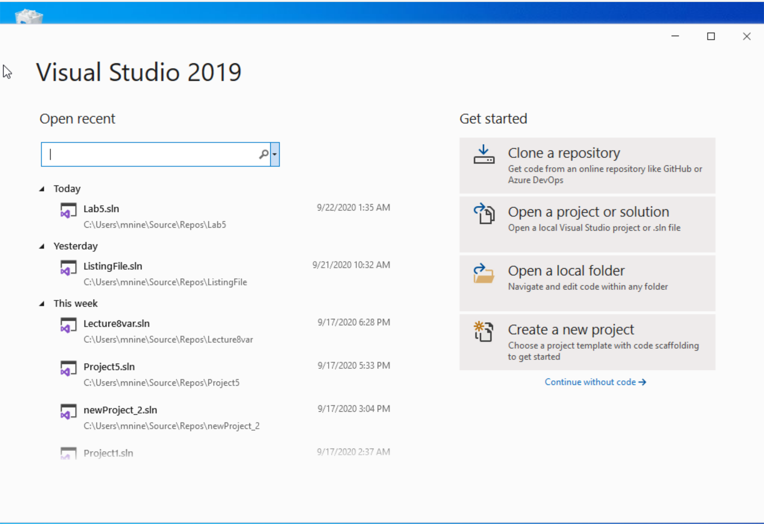


Step 1: Create a project (1)
Start Visual Studio
Click Create a new Project

Slide 23
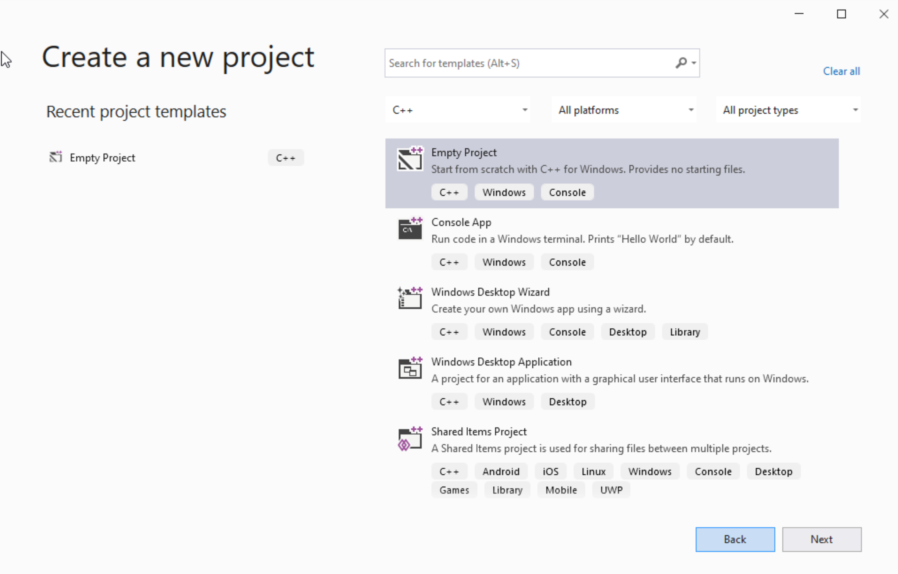




Step 1: Create a project (2)
Select C++ as language
Select Empty Project
Click Next

Slide 24
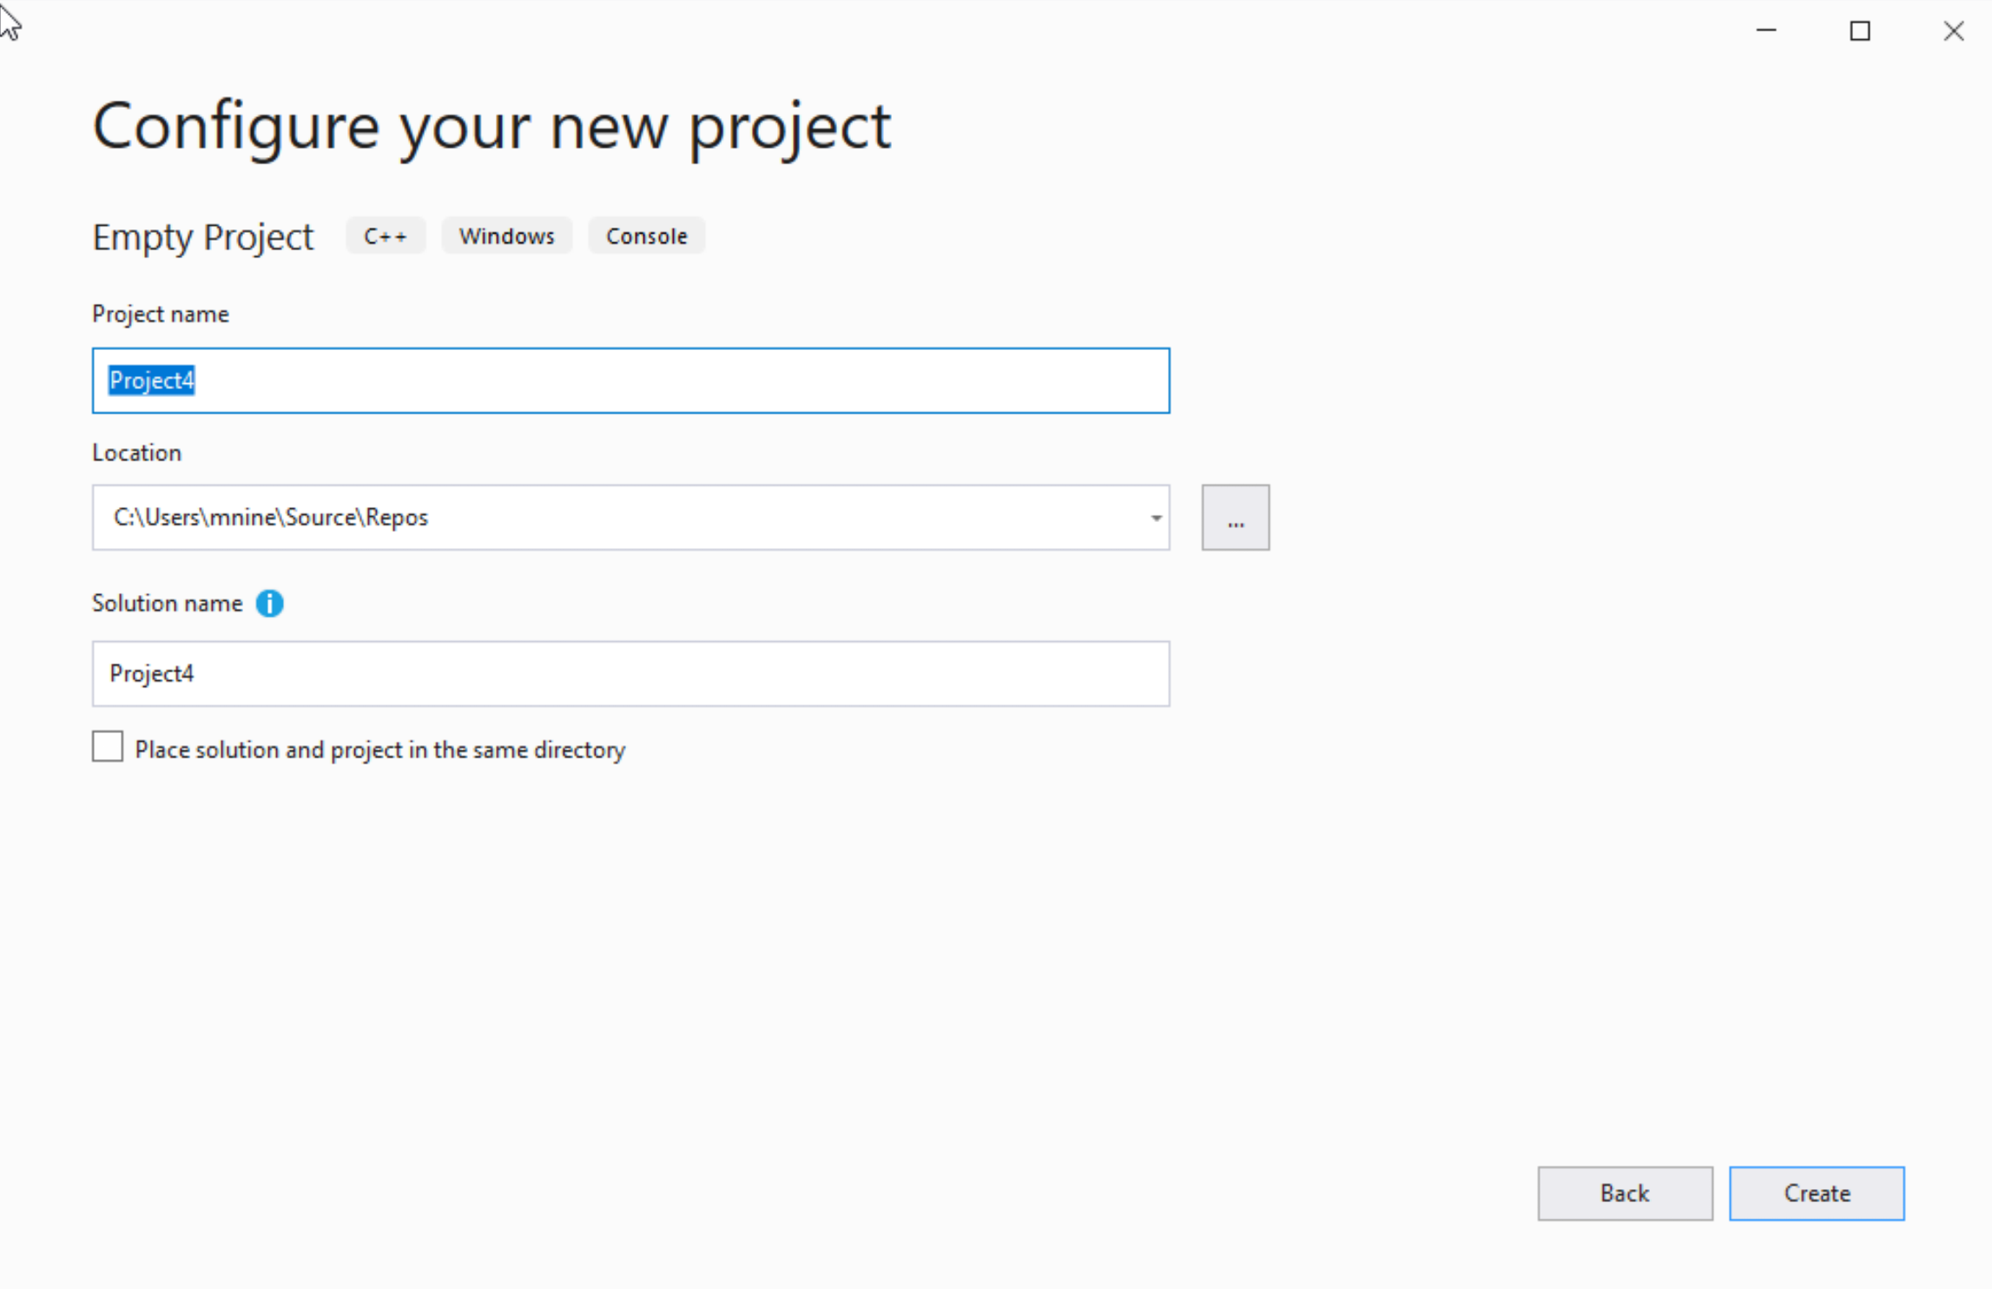

Step 1: Create a project (3)
You can change the project
name as you like
Also, you can change the
project location
Click Next

Slide 25
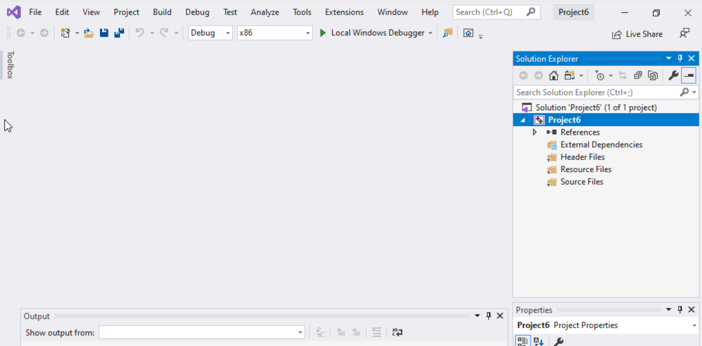
Step 1: Create a project (4)
Delete the
Following folders:
Header files
Resources Files, and
Source Files

Slide 26
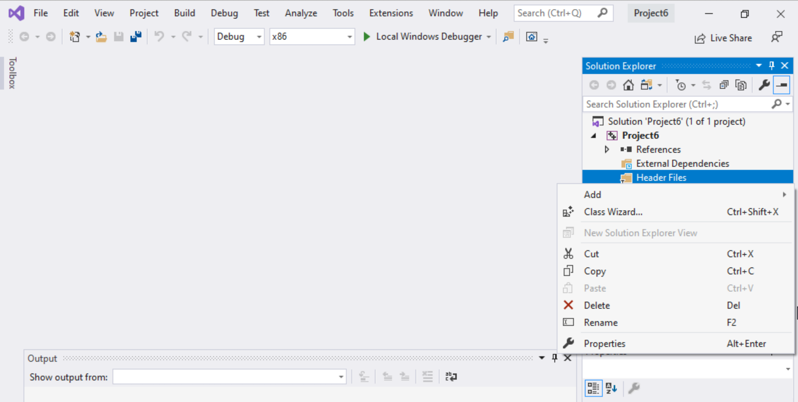
Step 1: Create a project (5)
To delete :
Select the folders
Right click on it
Select delete

Slide 27
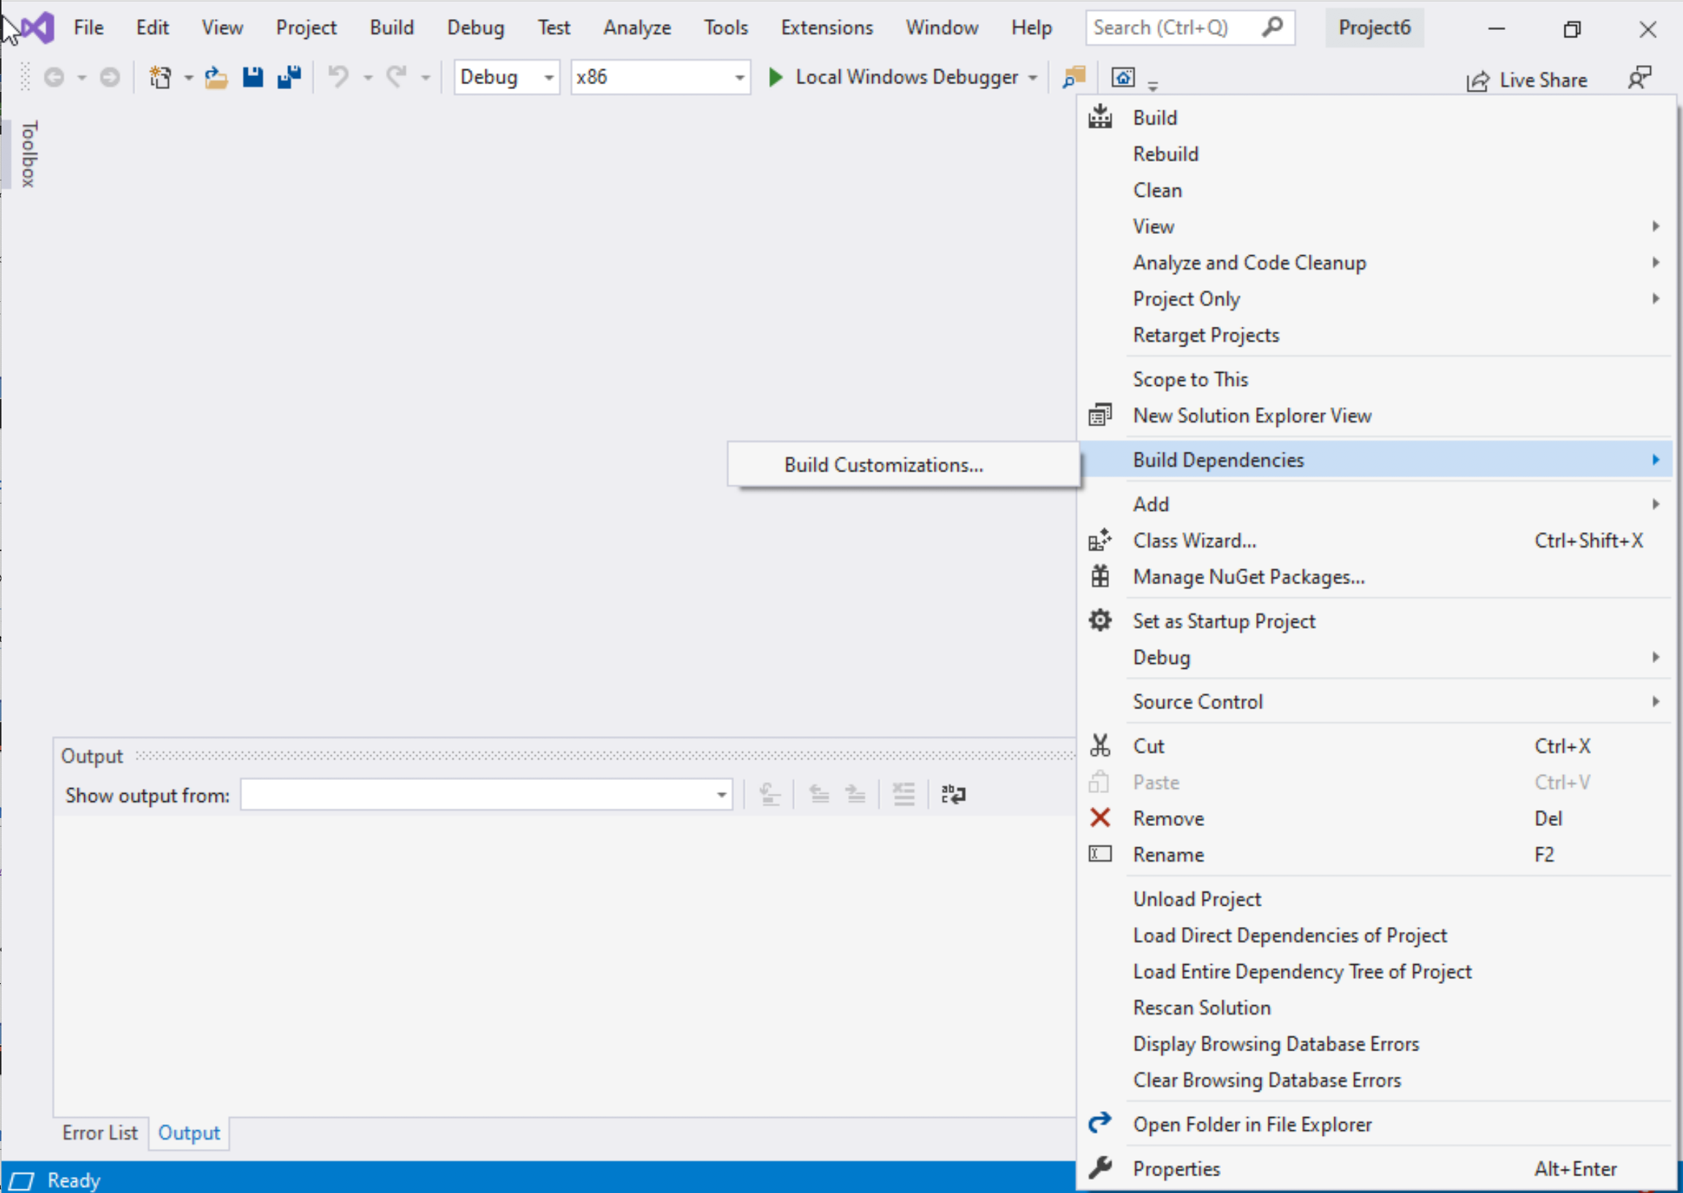
Step 1: Create a project (6)
Select Project Name on solution explorer
Right click on it
Go to Build Dependencies
Click on Build Customizations

Slide 28
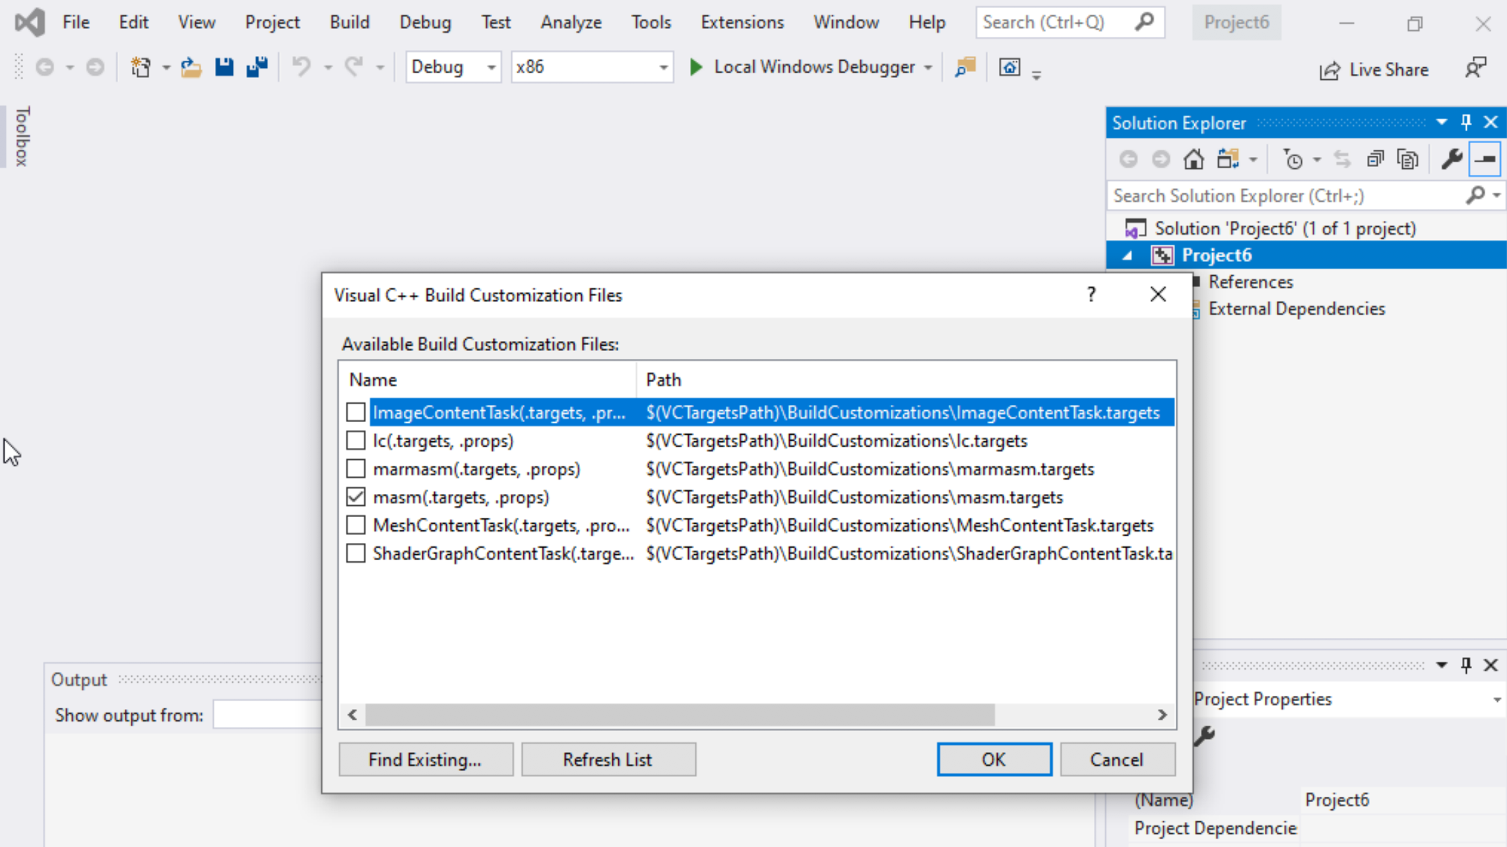
Step 1: Create a project (7)
Select masm(.target, .props)
Click ok

Slide 29
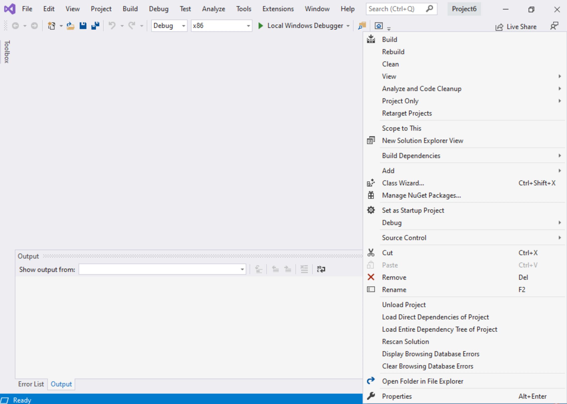
Step 1: Create a project (8)
Right click on the Project name in the solution explorer
Click properties

Slide 30
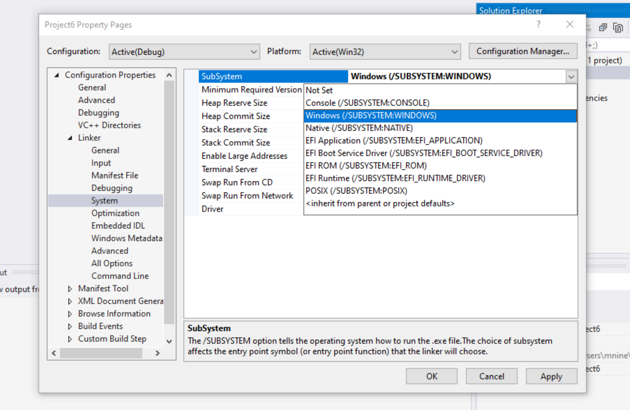

Step 1: Create a project (9)
Expand the ‘Linker’
Select ’System’
Select Windows(/SUBSYSTEM:WINDOWS)
Click OK

Slide 31
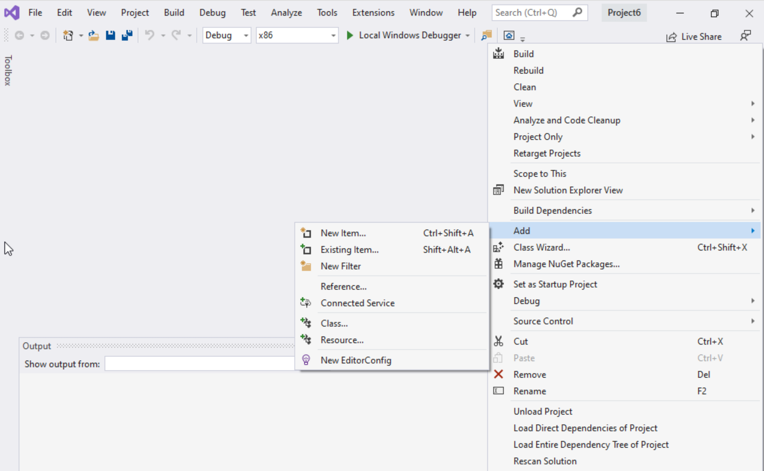
Step 1: Create a project (10)
Select Project name on solution explorer
Right click on it
Expand Add
Choose New Item

Slide 32
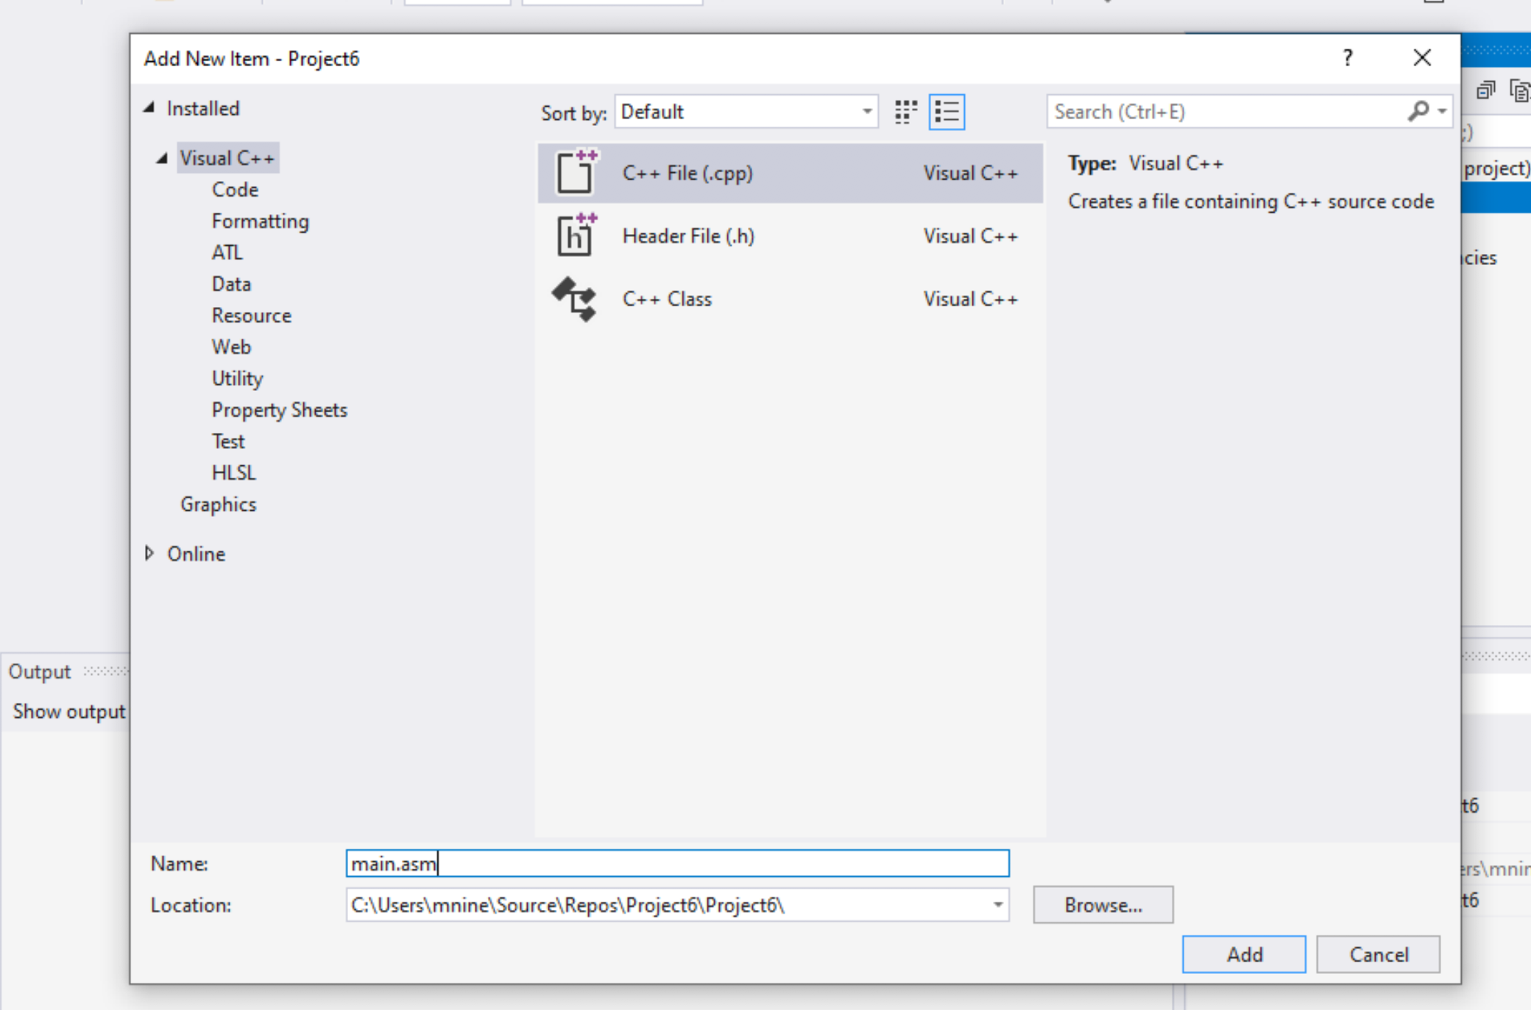


Step 1: Create a project (11)
Select C++ File(.cpp)
Name: main.asm
Click Add

Slide 33
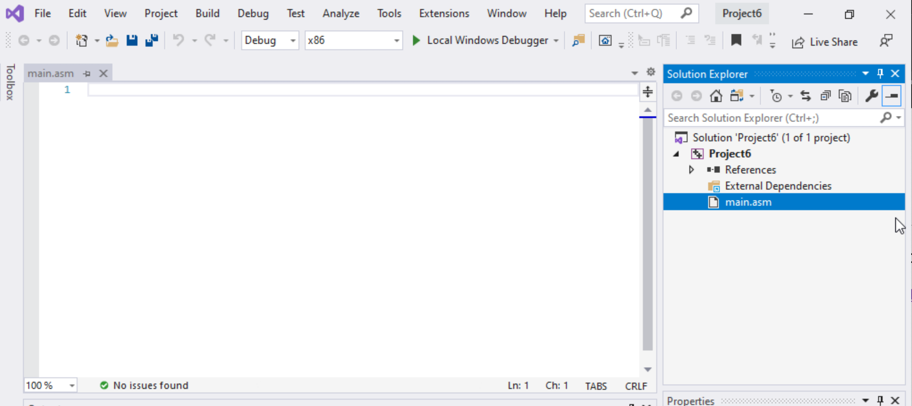

Step 1: Create a project (12)
Select main.asm
Add your code
In the main.asm File.

